Slide 1
Call Center Simulation in NS-3 and Node.js
Project Advisor:​
Dr. Tariq Mahmood Jadoon​
Ammarah Azmat Hira Tariq​
Muhammad Shamaas Zarmeen Khan​

Slide 2

Call Center Queuing Model

Slide 3
Senior Year Project I

Slide 4
Senior Year Project I Overview
We modeled a real life call center in NS-3 using a packet switched network where duration of calls was equal to length of the packet. If no agents were idle, packets were stored in a Linked List Queue.
Erlang C: A basic call center model with no Caller Abandonments and light call traffic.
Erlang X: A more complex and realistic call center model with heavy call traffic, caller abandonments, call drops and skill based routing.
Real Call Center: Replicated a real call center by studying it’s call records.
Routing Schemes: Skill Based Routing, Fastest Server First, Longest Idle First and Lowest Cost Routing were tested.
Data Analysis: Calculated Performance metrics of our Call Center.

Slide 5
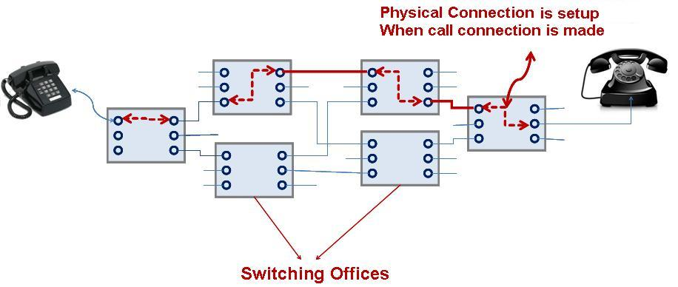
Simulating inherent Circuit Switched model as Packet Switched in NS3.

Slide 6



Block Diagram
Receiver and Distributor Node
Agent Node 1
Caller Node
Point To Point Link
Point To Point Link
Virtual Response Unit
Agent Node 2
Queue
Point To Point Link

Slide 7
IP Packet
Patience counter (TTL Tag)
200
Skill (TOS Tag) 1010
Source Address
Destination Address
Packet Size 50
VRU Counter 50

Slide 8
Caller Queue
Tail Link
Link 2
Link 1
Head Link
Front Pointer
Front Pointer
Front Pointer
DEQUEUE
ENQUEUE
Enqueue
IP Packet
IP Packet
IP Packet
IP Packet
IP Packet
IP Packet
Skill 1
Skill 3
Skill 1
Skill 3
Patience 25
Patience 15
Patience 0
Patience 5
Abandonment
IP Packet

Slide 9
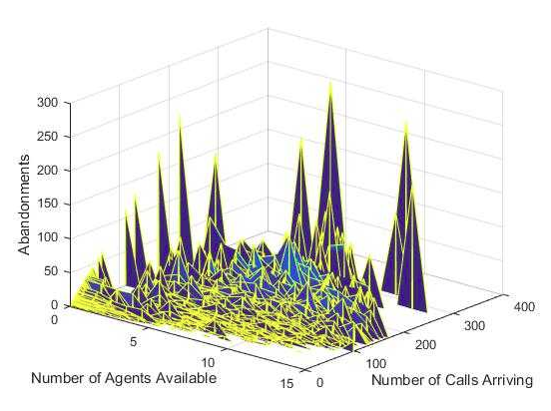
Real Call Center Results for 1 year

Slide 10
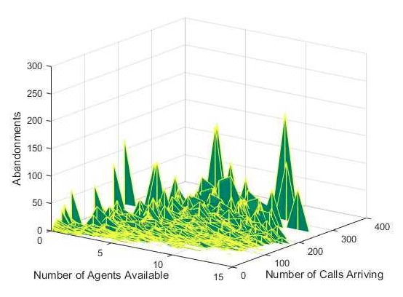
Simulation in NS-3 for 1 year Pearson correlation coefficient = 0.92

Slide 11
Data Analysis
Performance Metric | Value
Arrivals Per Minute | 1.038
Mean Packet Size | 169.577s
Blocking Percentage | 0%
Average Patience | 785s
Abandonments Percentage | 0.268276%
Mean Waiting Time | 0.131809s
Call Resolution | 1487/1489
Net Promoter Score | 71.8521
Agents Utilization | 15.343%
First Call Resolution | 100%
Average Time in System | 174s
Total Wages | Rs.37489
Quality Scores | 1483
Waiting Probability | 0.402414%
Service Level | 99%
Traffic Intensity | 2.9337

Slide 12
Routing Schemes

Slide 13
Senior Year Project II

Slide 14
Senior Year Project II Overview
We made an internet based call center application in Node.js which allows users to connect their internet devices to our HTTPS Server using an IP Address and Port, even through firewalls and NATs.
The user can choose to become an Agent or a Caller on Home Page.
Signaling for Javascript Session Establishment is done using Socket.io Library.
Caller and Agent stream live audio and Files using WebRTC Point To Point Connection.

Slide 15

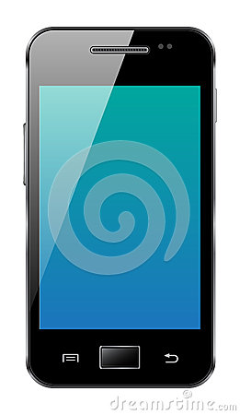



Block Diagram
Caller Node 1
Agent Node 1
WebRTC
HTTPS and Socket.io
HTTPS and Socket.io
HTTPS Server
Queue
Routing List
Agent Node 2
Caller Node 2
HTTPS and Socket.io
HTTPS and Socket.io
WebRTC

Slide 16


Slide 17
WebRTC
Real-time communication without plugins
Historically, Real Time Communication has been corporate, complex and expensive.
In May 2011, Ericsson built the first implementation of WebRTC.
WebRTC has now implemented open standards for real-time, plugin-free video, audio and data communication.
The guiding principles of the WebRTC project are that its APIs should be open source, free, standardized, built into web browsers and more efficient than existing technologies.
WebRTC is used in various apps like WhatsApp, Facebook Messenger, appear.in and platforms such as TokBox and in IOS Browsers.

Slide 18
Standards and protocols
The WebRTC W3C Editor's Draft
W3C Editor's Draft: Media Capture and Streams (aka getUserMedia)
IETF Working Group Charter
IETF WebRTC Data Channel Protocol Draft
IETF JSEP Draft
IETF proposed standard for ICE
IETF RTCWEB Working Group Internet-Draft: Web Real-Time Communication
RFC 5245, 5389, 5766, 6544.

Slide 19
WebRTC support summary
MediaStream and getUserMedia:
Chrome, Opera , Firefox and Microsoft Edge
RTCPeerConnection:
Chrome, Opera and Firefox
RTCDataChannel:
Chrome, Opera and Firefox

Slide 20
WebRTC Applications
• Get streaming audio, video or other data using getUserMedia.
• Get network information such as IP addresses and ports, and exchange this with other WebRTC clients (known as peers) to enable connection, even through NATs and firewalls.
• Coordinate signaling communication to report errors and initiate or close sessions.
• Exchange information about media and client capability, such as resolution and codecs.
• Communicate streaming audio (RTC PeerConnection) or data (RTC Data Cannel).

Slide 21
Signaling: session control, network and media information
WebRTC uses RTCPeerConnection to communicate streaming data between browsers (aka peers), but also needs a mechanism to coordinate communication and to send control messages, a process known as signaling.
Signaling is not part of the RTC PeerConnection API. We used Socket.io Library for signaling.
Signaling is used to exchange three types of information:
• Session control messages: to initialize or close communication and report errors.
• Network configuration: to the outside world, what's my computer's IP address and port?
• Media capabilities: what codecs and resolutions can be handled by my browser?

Slide 22
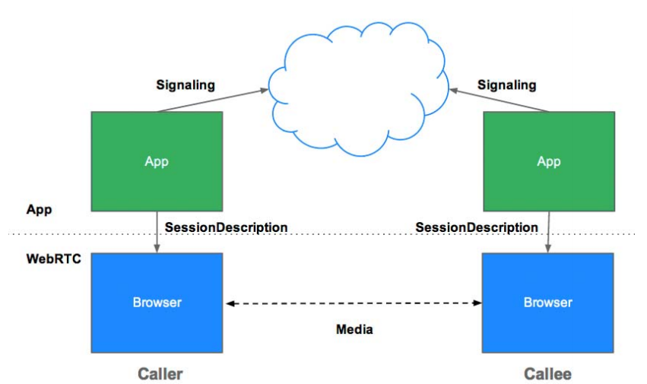
Architecture
Internet

Slide 23
MediaStream (aka getUserMedia)
The MediaStream API represents synchronized streams of media.
Each MediaStream has an input, which might be a MediaStream generated by navigator.getUserMedia(), and an output, which is passed to a RTC Peer Connection.
The getUserMedia() method takes three parameters:
A constraints object.
A success callback which, if called, is passed a MediaStream.
A failure callback which, if called, is passed an error object.
Each MediaStream has a label
An array of MediaStreamTracks is returned by the getAudioTracks() and getVideoTracks().

Slide 24
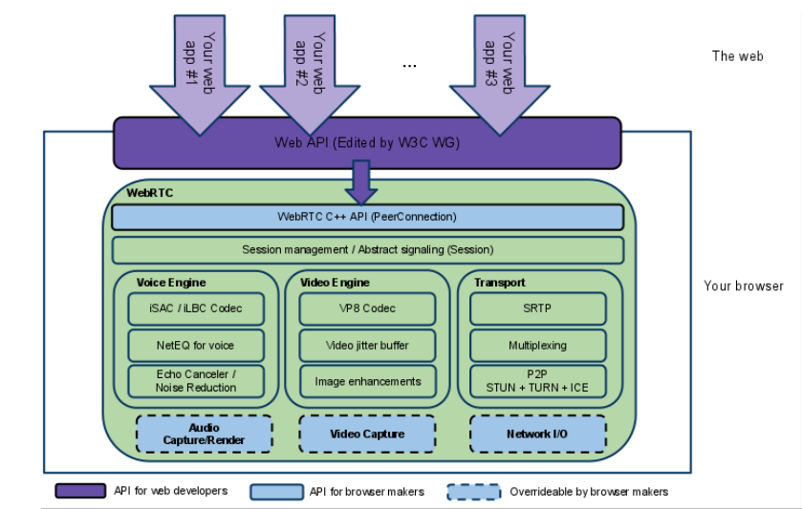
RTCPeerConnection

Slide 25
Interactive Connectivity Establishment ( ICE )
ICE framework uses STUN and TURN to enable RTC Peer Connection to cope with NAT traversal. The expression 'finding candidates' refers to the process of finding network interfaces and ports.
Session Traversal Utilities for NAT ( STUN ): Initially, ICE tries to connect peers directly via UDP. In this process, STUN servers try to enable a peer behind a NAT to find out its public address and port.
Traversal Using Relays around NAT (TURN): If UDP fails, ICE tries TCP: first HTTP, then HTTPS. If direct connection fails—in particular, because of enterprise NAT traversal and firewalls—ICE uses an intermediary (relay) TURN server.

Slide 26
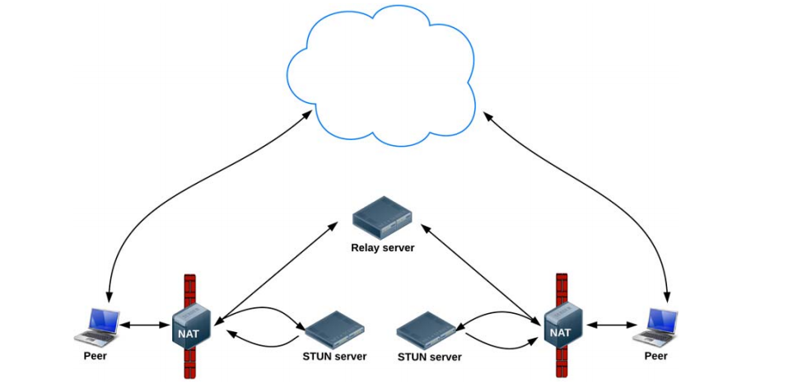
ICE : STUN and TURN
Internet

Slide 27
RTCDataChannel
The RTCDataChannel API enables peer-to-peer exchange of arbitrary data, with low latency and high throughput.
The API has the following features:
• Leveraging of RTCPeerConnection session setup.
• Multiple simultaneous channels, with prioritization.
• Reliable and unreliable delivery semantics.
• Built-in security (DTLS) and congestion control.
• Ability to use with or without audio or video.
Communication occurs directly between browsers, so RTCDataChannel can be much faster than WebSocket.

Slide 28
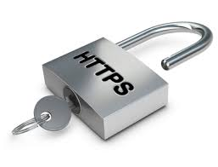

Slide 29
HTTPS (Secured Hyper Text Transfer Protocol)
HTTP Secure (HTTPS), extension of HTTP for secure communication
In HTTPS the communication protocol is encrypted by TLS
Motivation: protection of the privacy and integrity of the data while in transit
HTTPS creates a secure channel over an insecure network
TLS ensures security of HTTPS through encryption
HTTPS URLs begin with "https://" and use port 443 by default, whereas HTTP URLs begin with "http://" and use port 80 by default.
HTTP operates at the Application layer as does the TLS security protocol which encrypts an HTTP message prior to transmission and decrypts a message upon arrival.
Notes:
HTTP Secure (HTTPS) is an extension of the Hypertext Transfer Protocol (HTTP) for secure communication over a computer network, and is widely used on the Internet.^{[1][2]} In HTTPS, the communication protocol is encrypted by Transport Layer Security (TLS), or formerly, its predecessor, Secure Sockets Layer (SSL). The protocol is therefore also often referred to as HTTP over TLS,^{[3]} or HTTP over SSL.
The principal motivation for HTTPS is authentication of the accessed website and protection of the privacy and integrity of the exchanged data while in transit. It protects against man-in-the-middle attacks. The bidirectional encryption of communications between a client and server protects against eavesdropping and tampering of the communication.^{[4]} In practice, this provides a reasonable assurance that one is communicating without interference by attackers with the website that one intended to communicate with, as opposed to an impostor.
HTTPS creates a secure channel over an insecure network. Over insecure networks (such as public Wi-Fi access points), as anyone on the same local network can packet-sniff and discover sensitive information not protected by HTTP. This ensures reasonable protection from eavesdroppers and man-in-the-middle attacks, provided that adequate cipher suites are used and that the server certificate is verified and trusted
The security of HTTPS is that of the underlying TLS, which typically uses long-term public and private keys to generate a short-term session key, which is then used to encrypt the data flow between client and server. Certificates are used for the server’s authentication. As a consequence, certificate authorities and public key certificates are necessary to verify the relation between the certificate and its owner, as well as to generate, sign, and administer the validity of certificates. While this can be more beneficial than verifying the identities via a web of trust
Difference from HTTP[edit]
HTTPS URLs begin with "https://" and use port 443 by default, whereas HTTP URLs begin with "http://" and use port 80 by default.
HTTP is not encrypted and is vulnerable to man-in-the-middle and eavesdropping attacks, which can let attackers gain access to website accounts and sensitive information, and modify webpages to inject malware or advertisements. HTTPS is designed to withstand such attacks and is considered secure against them (with the exception of older, deprecated versions of SSL).
HTTP operates at the highest layer of the TCP/IP model, the Application layer; as does the TLS security protocol (operating as a lower sublayer of the same layer), which encrypts an HTTP message prior to transmission and decrypts a message upon arrival. Strictly speaking, HTTPS is not a separate protocol, but refers to use of ordinary HTTP over an encrypted SSL/TLS connection.

Slide 30
HTTPS Server in Node.js
Node.js is a free open source framework
Uses java script on the server
Node.js runs on various platforms (Windows, Linux, Unix, Mac OS etc.)
Node.js uses asynchronous programming!
Advantages of Asynchronous Programming:
Avoids freezing of browsers
Improved speed
Improved performance
Notes:
Node.js is an open source server framework
Node.js is free
Node.js runs on various platforms (Windows, Linux, Unix, Mac OS X, etc.)
Node.js uses JavaScript on the server
Asynchronous programming will avoid freezing of browsers, Improved speed of the website applications. Improved performance when multiple client using web services at the same time. Fault tolerance. We can get rid of the DOM updates getting blocked, CSS animation and user interactions (right clicking, text selection etc) getting freez.

Slide 31
PHP or ASP vs Node.js file request handling mechanism
PHP or ASP
1. Sends the task to the computer's file system.
2. Waits while the file system opens and reads the file.
3. Returns the content to the client.
4. Ready to handle the next request.
Node.js
1. Sends the task to the computer's file system.
2. Ready to handle the next request.
3. When the file system has opened and read the file, the server returns the content to the client.

Slide 32
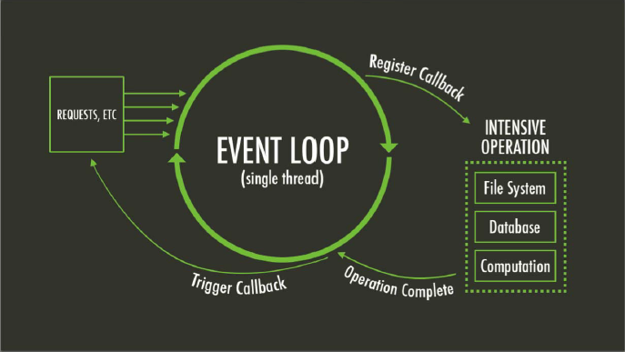
Event Loop
1) fs.readFile (‘fileA.html', function(error, data){CallBack Code;})
2) fs.writeFile (‘fileB.html', function(error, data){CallBack Code;})
3) socket.on ('TextMessage', function(Message){ SendToPeer(socket, 'TextMessage', Message);
4) socket.on ('answer', function(answer){SendToPeer(socket, 'answer', answer);

Slide 33
Secure Network
SSL (Secure Sockets Layer) & TLS (Transport Layer Security), are both protocols used for the encryption of network data
Ensures privacy between communicating applications and their users on the Internet
Use unique secret keys for the symmetric encryption to secure the privacy
Used in applications such as web browsing, email, instant messaging, and voice over IP (VoIP)
Notes:
SSL (Secure Sockets Layer) and TLS (Transport Layer Security) these are the protocols that ensures privacy between communicating applications and their users on the Internet. TLS is an updated and more secured version of SSL. Both SSL and TLS is used to encrypt confidential data sent over an insecure network such as the Internet.
are cryptographic protocols that provide communications security over a computer network
These standard security technologies establishes an encrypted link between a web server and a browser. This link ensures that all data passed between the web server and browsers remain private and integral.
The connection is private (or secure) because symmetric cryptography is used to encrypt the data transmitted. The keys for this symmetric encryption are generated uniquely for each connection and are based on a shared secret negotiated at the start of the session (see § TLS handshake).

Slide 34
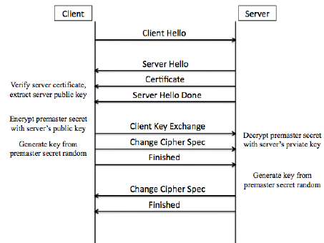
TLS Handshake
Notes:
A cypher suit is the set od algorithms that help to secure the network connection that uses TLS/SSL
A client sends a ClientHello message specifying a list of suggested cipher suites and suggested compression methods.
The server responds with a ServerHello message, containing the suggested CipherSuite and compression method from the choices offered by the client.
The server sends its Certificate message
The server sends its ServerKeyExchange message
The server sends a ServerHelloDone message, indicating it is done with handshake negotiation.
The client responds with a ClientKeyExchange message, which contain a PreMasterSecret, public key. This PreMasterSecret is encrypted using the public key of the server certificate.
The client and server then use the random numbers and PreMasterSecret to compute a common secret, called the "master secret". All other key data for this connection is derived from this master secret
The client now sends a ChangeCipherSpec record, essentially telling the server, "Everything I tell you from now on will be authenticated (and encrypted if encryption parameters were present in the server certificate)
Finally, the client sends an authenticated and encrypted Finished message, containing a hash and MAC over the previous handshake messages.
The server will attempt to decrypt the client's Finished message and verify the hash and MAC. If the decryption or verification fails, the handshake is considered to have failed and the connection should be torn down.
Finally, the server sends a ChangeCipherSpec, telling the client, "Everything I tell you from now on will be authenticated (and encrypted, if encryption was negotiated).“
The server sends its authenticated and encrypted Finished message.
The client performs the same decryption and verification procedure as the server did in the previous step.
Application phase: at this point, the "handshake" is complete and the application protocol is enabled. Application messages exchanged between client and server will also be authenticated and optionally encrypted exactly like in their Finished message.

Slide 35




Digital Certificates
With TLS/SSL, all servers must have a certificate.
How to obtain a certificate:
Step 1: Create a Certificate Signing Request (CSR) file.
Step 2: Certificate Authority / Self-Signed Certificate
Step 3: Generate a .pfx or .p12 file:
Privacy Enhanced Mail Certificates, Public Key Cryptography Standard #12 file, Personal Information Exchange Certificate and Private File.
Notes:
After first point describe the term certificate:
Certificates are public keys that are digitally signed either by a Certificate Authority or by the owner of the private key. Those certificates that are signed by the owner of the private key are referred to as "self-signed“. In turns these certificates correspond to a private key.
The first step to obtaining a certificate is to create a Certificate Signing Request (CSR) file. The OpenSSL command-line interface can be used to generate a CSR for a private key
Once the CSR file is generated, it can either be sent to a Certificate Authority
for signing or used to generate a self-signed certificate.
Once the certificate is generated, it can be used to generate
a .pfx or .p12 file:

Slide 36
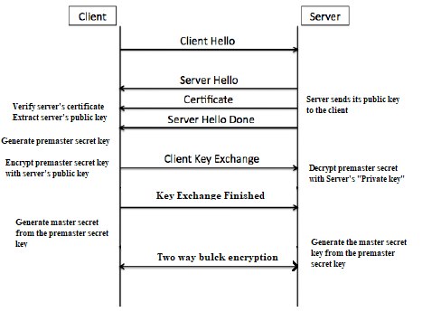
TLS public/private key attack
Notes:
Secure communication with the server… TLS handshake.
When a client communicates with the server, The client send the client “Hello’ message which is the beginning of the communication, then the server sends back the certificate which includes the public key that the server has. The public key is already shared to everyone…and then the client computes the premaster secret after computing the premaster key it encrypts it using the public key of the server and sends it to the server.
The server can then use its private key to then decrypt that encrypted premaster key.. Now the server has the premaster secret. Now from the premaster secret the client and the server both generates the master secret and the session key which then leads to bulck encryption…….RSA encryption algotithm…search
But what happens if the private key is ever compromised either by the hackers or the security agencies. If the hacker can ever gets the private key and then what he can do is that he can decrypt the premaster key sent by the client and then he can generate from that premaster secret the actual secret key that is being used in the bulck encryption and can decrypt any information from the secret key…. To order to avoid this situation, the perfect forward secrecy comes into play..
Side Info…
In the hello message there is the set of the cipher suites that are offered up by the client and the server have also the set of the cypher suites then the server chooses which cypher suite is going to be used in this whole communication
If you encrypt something with the public key, the only thing that decrypt it is the private key.

Slide 37
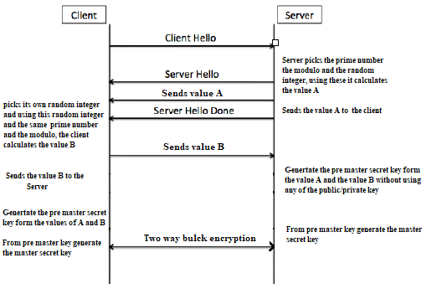
Perfect Forward Secrecy
Notes:
Client sends the hello message as normal and then what the server’s going to do is that the server then generates a prime number and also the modulo and sends back to the client but also a sit sends back to the client…..Diffie helmen key exchange
It never relies on the server or the client using their public or private key in order to exchange the premaster secrets and ultimately the keys.
Server picks the known prime number and the modulo and then it picks the random integer from this it calculates the value: the value A
The client will pick its own random integer and using the same prime number and modulo and also using the value of A it calculates its value: the value for B and sends that value B back to the server.
Through the values of A and B they both can generate the premaster secret. So they both have the pre master secret and they've got it without using any of their private key. And using this premaster secret, both generate the secret key and then starts communicating. Also these randomly chosen integers are ephemeral (short lived).
Brand new random integers are chosen all the time… ephemeral key exchange. And even if someone grab hold of the random integer.. .then the communication of that one channel will be compromised but the next time its completely different key…

Slide 38
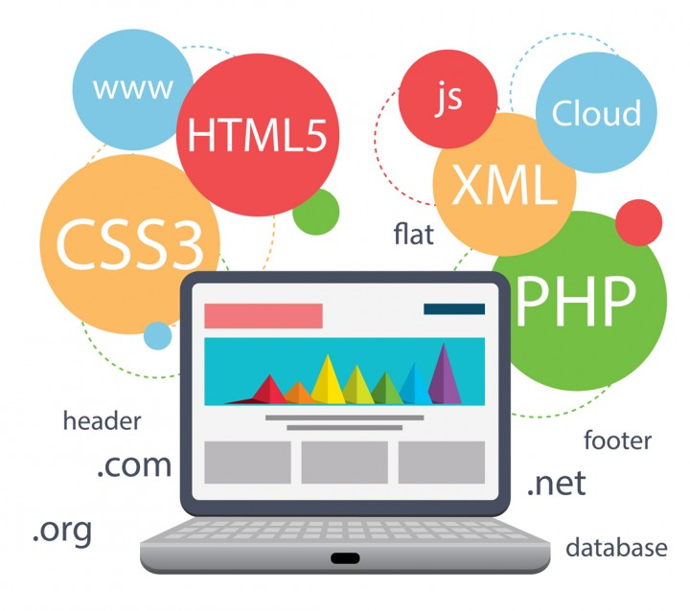
HTML Pages

Slide 39
Server App.js
Require modules:
Fs: for handling file system(CallCentre, Caller and agent html page)
http: to make Node.js act as HTTP server (similarly https for secured)
Socket.io: real time event-based communication (request, response between caller and agent)
Caller, Agent socket Array for pairwise connection
Socket.io Events:
‘Type’: user defines if it wants to be agent/caller
‘ICECandidate’: sends ICE candidate
‘Offer’: sends Session Description Protocol SDP
‘TextMessage’: sends and receives text messages
‘Answer’: answer SDP to caller offer
‘FileInformation’: sends file information from caller and sends to agent
‘Disconnect’: fired when client(caller/agent) disconnects, count added to Drop variable

Slide 40
Caller
Server
Agent
Request 192.1.1.1:8000/Caller
Response Caller Web Page
Request 192.1.1.1:8000/Agent
Response Agent Web Page
getUserMedia
getUserMedia
PeerConnection PC1
PeerConnection PC2
PC1.addTrack(Local Stream)
PC2.addTrack(Local Stream)
Call button pressed
PC1.createOffer()
LocalDescription=Offer
socket.emit (“offer”)
socket.on (“Offer”)
Send Offer
Receive Offer
RemoteDescription=Offer
Receive Answer
socket.on (“answer”)
socket.emit (“answer”)
PC2.createAnswer()
RemoteDescription=Answer
socket.emit (“candidate”)
socket.on (“candidate”)
ICE Candidate arrived
PC2.setICECandidate
socket.on (“candidate”)
socket.emit (“candidate”)
ICE Candidate arrived
PC1.setICECandidate
Remote Stream arrived
Remote Stream arrived
Play RemoteStream
Play RemoteStream

Slide 41
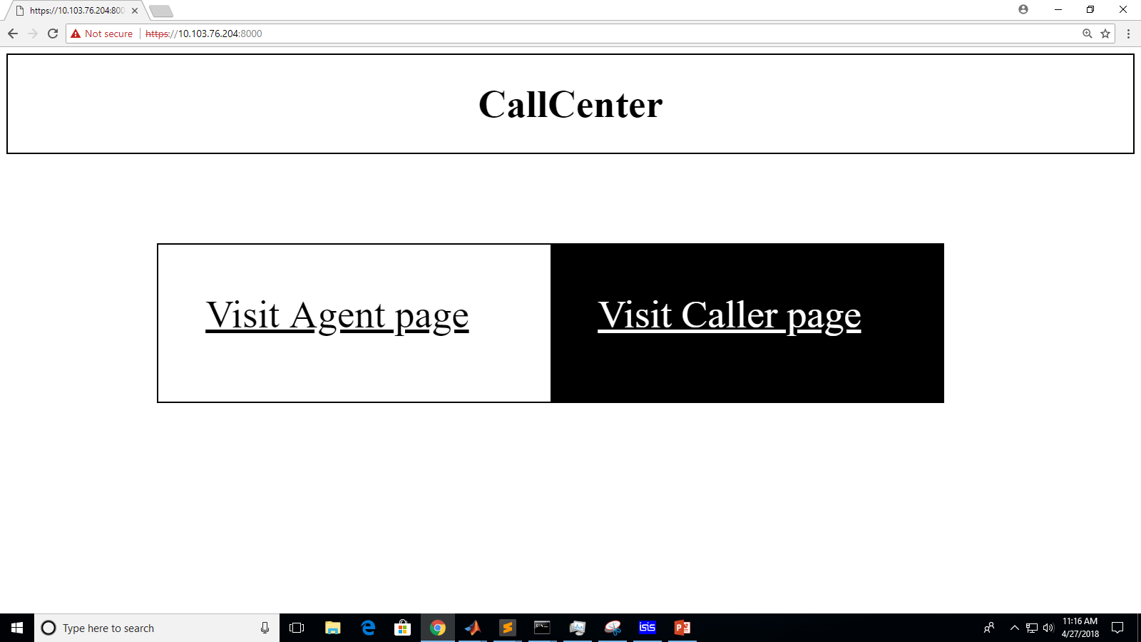
Call Centre Web Page
Home page which directs user to caller/agent page
Caller Web page initiates a call
Agent directed automatically if available in queue or idle
Access local and remote stream via WebRTC connection
Exchange of text messages
files sent and downloaded over data channel

Slide 42
HTML Syntax
<script> runs client-side script </script>
<textarea> display multiline input control </textarea>
<button> clickable button like: Submit, Receive </button>
<audio> define sound content of caller and agent </audio>
<video> defines video (exchanged by caller and agent) </video>
<img> image file exchanged over data channel </img>

Slide 43
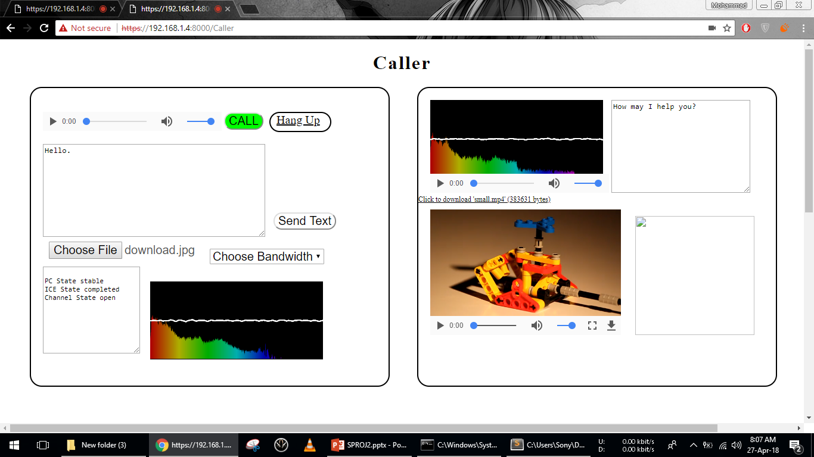
Caller Web page
Text box for receiving and sending messages
Remote stream of Agent
Local stream of caller
Received Video
Received Image

Slide 44
Caller Web page
User directed to caller.html via request: 192.1.1.1:8000/Caller
GetUserMedia to access user's camera and speaker
PeerConnection via RTC Peer Connection
AddTrack to get local stream
Initiates a call
CreateOffer for Signalling Server
Set localDescription and sends offer to Agent
Recieves agent SDP, sets as remoteDescription
ICE Candidate (communication behind NAT) via STUN/TURN
Sets RemoteStream
Creates Data Channel for exchanginf media

Slide 45
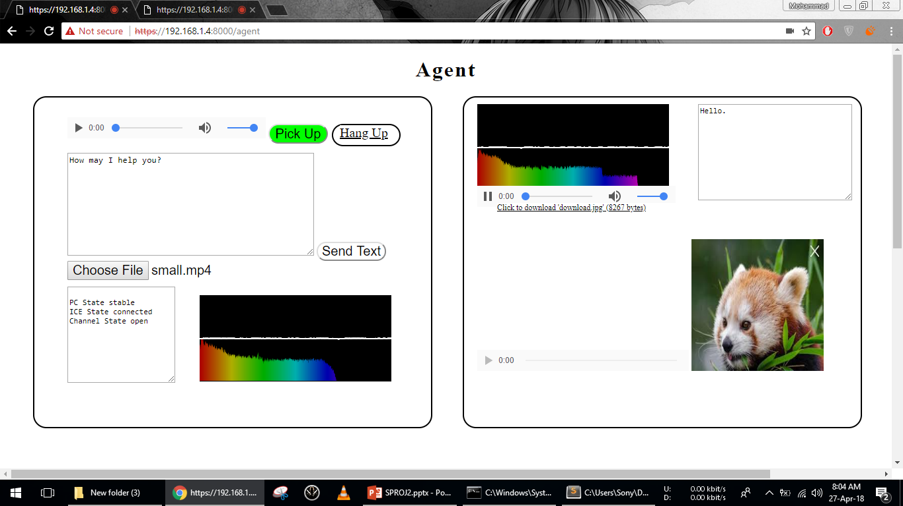
Agent Web page
Text box for receiving and sending messages
Remote stream of Agent
Received Video
Local stream of Agent
Received Image

Slide 46
Agent Web page
User connected to Agent.html via server response to 192.1.1.1:8000/Agent
Get UserMedia to access camera and speakers
Set up RTC peer connection
AddTrack to get local stream
Respond to caller's call
Recieves 'offer' , sets caller RemoteDescription and emits localDescription
ICE candidate arrived of caller, set remoteStream
Recieves Data Channel

Slide 47
Additional Features
Log File for Call Records.
Calculation of Performance Metrics at Server.
Change Bandwidth on the fly: 125Hz, 250Hz, 500Hz, 1000Hz, Unlimited Bandwidth.
Choose Audio Codec from a list: iLBC (Default), iSAC 16K, Opus, G722, PCMU.
Stream visualizer shows Fourier Transform of Audio Signal.
Group Calls through multiple RTC PeerConnections.
Various Routing Schemes.

Slide 48
Review
We modeled a real life call center in NS-3 using a packet switched network where duration of calls was equal to length of the packet. If no agents were idle, packets were stored in a Linked List Queue.
We made an internet based call center application in Node.js which allows users to connect their internet devices to our HTTPS Server using an IP Address and Port, even through firewalls and NATs.
The NS-3 Simulator serves to test and improve performance of Node.js Call Center.

Slide 49
Timeline
Date | Progress
Feb 5 – Feb 18 | Carried out Research through online tutorials and documentation for Node.js, socket.io and WebRTC.
Feb 19 – Mar 4 | Zarmeen Khan: Wrote code for home page and Server. Hira Tariq: Wrote code for getting Audio stream and TLS certificate and key generation. Ammarah Azmat: Wrote code for RTC Offer and Answer SDP generation.
Mar 5 – Mar 18 | Zarmeen Khan: Wrote code for disconnections and Type Selection. Hira Tariq: Wrote code for Routing and text messaging between peers. Ammarah Azmat: Wrote code for receiving and sending ICE candidates. Muhammad Shamaas: Tested Code by Sending messages between peers.
Mar 19 – Apr 1 | Zarmeen Khan: Wrote Code for call button, text box and audio element. Hira Tariq: Wrote Code for RTC Data Channel. Ammarah Azmat: Wrote code for sending and receiving files. Muhammad Shamaas: Simulated NS3 Call Center for 1 year.
Apr 2 – Apr 15 | Zarmeen Khan: Wrote code for Hang Up Link and Call Tone. Hira Tariq: Wrote code for displaying image and video. Ammarah Azmat: Added Pick Up button, connection states. Muhammad Shamaas: Wrote code for stream visualizer.
Apr 16 – Apr 29 | Zarmeen Khan: Made Log File and calculated Performance Metrics. Hira Tariq: Plotted NS3 Simulation Results and made Comparison with Real Call Center. Ammarah Azmat: Made Codec Selector and Bandwidth Selector. Muhammad Shamaas: CSS Design of Web Pages.
Apr 30 | Design and Simulation Group SPROJ II Presentation.

Slide 50
References
[1] “Interactive Connectivity Establishment (ICE): A Methodology for Network Address Translator (NAT) Traversal for Offer/Answer Protocols.” IETF Tools, tools.ietf.org/html/rfc5245.
[2] “Javascript Session Establishment Protocol.” IETF Tools, tools.ietf.org/html/draft-uberti-rtcweb-jsep-02.
[3] “Navigator.” MDN Web Docs, developer.mozilla.org/en-US/docs/Web/API/Navigator.
[4] “Node.js v8.11.1 Documentation.” Index | Node.js v8.11.1 Documentation, nodejs.org/dist/latest-v8.x/docs/api/.
[5] Npm Documentation, docs.npmjs.com/.
[6] “Privacy Indicator Requirements.” Media Capture and Streams, w3c.github.io/mediacapture-main/getusermedia.html.
[7] “RTCDataChannel.” MDN Web Docs, developer.mozilla.org/en-US/docs/Web/API/RTCDataChannel.
[8] “RTCPeerConnection.” MDN Web Docs, developer.mozilla.org/en-US/docs/Web/API/RTCPeerConnection.
[9] “Rtcweb Status Pages.” IETF, tools.ietf.org/wg/rtcweb/charters.
[10] “Session Description Protocol.” Wikipedia, Wikimedia Foundation, 10 Apr. 2018, en.wikipedia.org/wiki/Session_Description_Protocol.
[11] “Session Traversal Utilities for NAT (STUN).” IETF Tools, tools.ietf.org/html/rfc5389.
[12] Socket.IO - Docs, socket.io/docs/.
[13] “TCP Candidates with Interactive Connectivity Establishment (ICE).” IETF Tools, tools.ietf.org/html/rfc6544.
[14] “Traversal Using Relays around NAT (TURN): Relay Extensions to Session Traversal Utilities for NAT (STUN).” IETF Tools, tools.ietf.org/html/rfc5766.
[15] WebRTC 1.0: Real-Time Communication Between Browsers, w3c.github.io/webrtc-pc/
[16] “WebRTC Data Channel Protocol.” IETF Tools, tools.ietf.org/html/draft-jesup-rtcweb-data-protocol-01.
[17] “Web Real-Time Communication Use Cases and Requirements.” IETF Tools, tools.ietf.org/html/draft-ietf-rtcweb-use-cases-and-requirements-10.
[18] Webrtc. “Webrtc/Samples.” GitHub, github.com/webrtc/samples/.

